Slide 1
EMPLOYEE SURVEY TURNOUT
ABOUT
BUDGET
PROJECT
TIMELINE
Prepared by: Marcus Morante

Slide 2
SCOPE
INITIAL ANALYSIS
TABLE OF CONTENTS
EVEN MORE ANALYSIS
RECOMMENDATIONS
01
02
What data was used
Range
Filters
What information you can get just by looking at it
03
04
What other information lurks under the surface
Call to action

Slide 3

Employee Survey
SCOPE
INITIAL ANALYSIS
EVEN MORE ANALYSIS
RECOMMENDATIONS
The Scope of Analysis is coming from Federal Viewpoint Survey with the following files extracted for usage:
Employee Engagement Index Results by Agency
Global Satisfaction Index Results by Agency
Performance Confidence Index Results by Agency
DEIA Index Results by Agency
Response Rate by Agency
Tool used for developing this analysis:
Jupyter Notebook (python)
Excel
Powerpoint
PROJECT PROPOSAL

Slide 4
Employee Engagement Index Results
SCOPE
INITIAL ANALYSIS
EVEN MORE ANALYSIS
RECOMMENDATIONS
Overall Engagement Rating
Pass/Fail Breakdown by Agency Size
Employee Rating (%) by Management Level
81% of the listed Organization rated 70% and up
Key Takeaways / Anecdotes:
Majority of the organizations that fail falls under those who were categorized as Very Small Organization
It appears that Employees have more trust with their supervisors compared to their Leader’s Lead

Slide 5
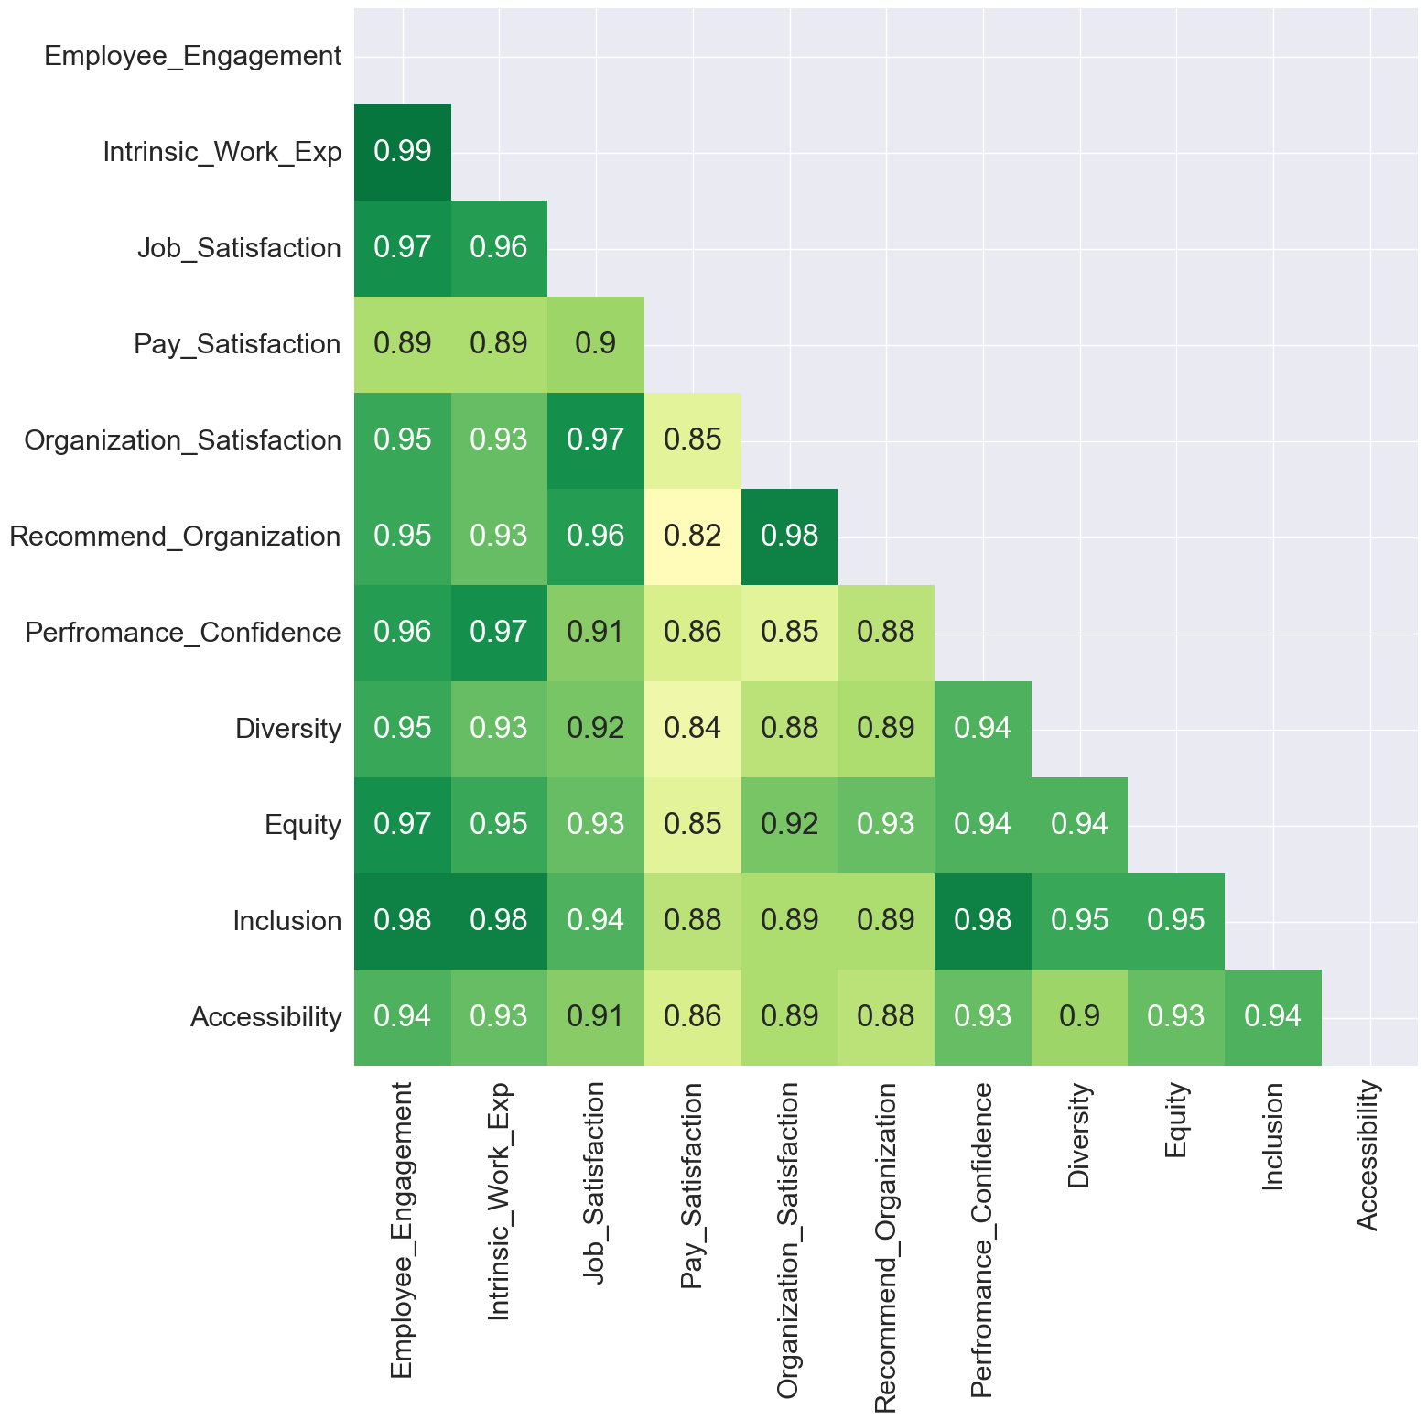
Other Factors that may affect Engagement Rating
SCOPE
INITIAL ANALYSIS
EVEN MORE ANALYSIS
RECOMMENDATIONS
Correlation
Linear Regression Coefficient
Key Takeaways / Anecdotes:
Correlation:
All is strongly correlated with one another
Pay Satisfaction somehow bleeds to other variables as an indicator when answering some question related to DEIA Index, Performance Confidence Index and Global Satisfaction
Coefficient:
Movements in coefficient value were observed, the variables considered in the survey shows an idea as to what are the actual things being considered by employees when casting votes on the survey

Slide 6
Call to Action
SCOPE
INITIAL ANALYSIS
EVEN MORE ANALYSIS
RECOMMENDATIONS
Very small organizations need some care as majority of the population who engaged on the survey in that group has a lot of sentiments that needs to be addressed by their leaders
Survey | Performance_Confidence | Inclusion | Intrinsic_Work_Exp | Employee_Engagement | Accessibility | Job_Satisfaction | Organization_Satisfaction | Equity | Recommend_Organization | Diversity | Pay_Satisfaction
Satisfaction Rate | 75% | 65% | 60% | 55% | 55% | 45% | 45% | 45% | 40% | 40% | 20%
Leader’s Lead also needs to run some skip-level sessions with the people in order to address the following needs as well as improve there Employee Engagement / Visibility in the organization
Results from the Correlation/Coefficient suggest that we should focus on the metrics being listed in DEIA Index and Global Satisfaction Index if we want to further drive the Employee Engagement metric
Take things with a grain of salt (somehow) as across all Organization, 69% of them have half of their employee population took the survey which means it is not indicative of the voice of the entire workforce
Notes:
60% in Very Small Organization met half of their population for taking a survey (25% of it are undetermined due to getting less than 10 survey samples)

